Slide 1

RIGHTIES vs.
LEFTIES in
2015

Slide 2
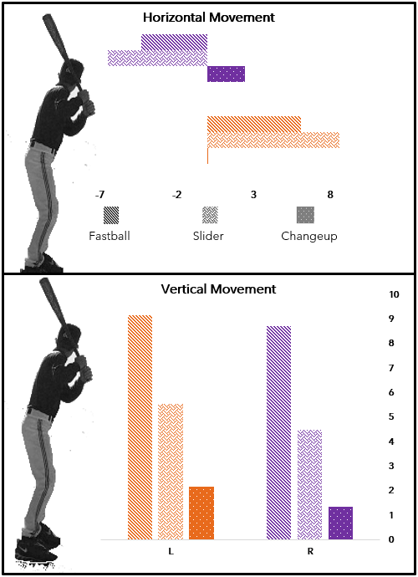
Right Hand Pitching moves
Toward a Right Handed Batter
Left Handed Pitching moves
Away from a Right Handed batter
Left Handed Pitchers in 2015
Exceed Right Handed Pitchers
In both Vertical and Horizontal
Pitch movement.

Slide 3
